Slide 1


FIRST HOME FINANCE

Slide 2
CONTENTS
What is First Home Finance?
First Home Finance Expanded Housing Finance Products
Current First Home Finance Subsidy Quantum
What the Subsidy can be used for?
Who can apply for the First Home Finance subsidy
Screening of Applications
Documents Required
Income considered and proof of source
How to apply for the subsidy
Application outcomes

Slide 3
WHAT IS FIRST HOME FINANCE ?
First Home Finance is a once-off housing subsidy that enables qualifying beneficiaries to buy or build their homes on an affordable basis
The Programme was developed by the Department of Human Settlements to enable sustainable and affordable first-time home-ownership opportunities to South African citizens and legal permanent residents
Target is Low to middle income households earning between R3 501 and R22 000 per month, (the ‘affordable’ or ‘gap’ market).
Households in these salary bands generally find it hard to qualify for housing finance; their income is regarded as low for mortgage finance, but too high to qualify for the government ‘free-basic house’ subsidy scheme.
Subsidy amount is a once-off subsidy on a sliding scale—dependent on household income:
  The lower the income, the higher the subsidy;
  Household with total gross income of R3 501 qualifies for maximum subsidy of R169 265
  Household with total gross in income of R22 000 qualifies for R38 911

Slide 4
FIRST HOME FINANCE IS OFFERED WITH EXPANDED HOUSING FINANCE PRODUCTS
New: Various Options—in addition to mortgage
Old: Mortgage Option
Subsidy only—i.e., subsidy can be used independent of any loan.
First Home Finance with an unsecured housing loan
First Home Finance with Pension Backed Loans
First Home Finance with GEHS
First Home Finance with Employer-Assisted Housing Scheme
First Home Finance with Community Schemes (e.g. Stokvel)
First Home Finance with instalment sale (Deed of alienation Act ) as well as Rent-to-Buy (Own) agreements
First Home Finance with own resources (savings)
Can be accessed with Permission to Occupy--PTO (Traditional Authority)
  Mortgage (Traditional FIRST HOME FINANCE)
  Implemented in urban areas where title to land is available
  Benefitted households in higher income brackets of FIRST HOME FINANCE market—R3 501—R22 000 p.m.

Slide 5

HIGH LEVEL: CURRENT SUBSIDY QUANTUM RANGE—w.e.f. 1 April 2023
GROSS INCOME BRACKET

Slide 6
WHAT FIRST HOME FINANCE CAN BE USED FOR?
    To buy an already-built house, whether brand new or existing
    To buy a housing stand but which must be: (1) connected to municipal services/off-the grid sources; (2) zoned for housing.
    To pay for the building of a house on a stand which the household/applicant already owns (including stands which are part of IRDP Projects) and which must be: (1) connected to municipal services/off the grid sources; (2) zoned for housing; (3) enrolled with NHBRC; and (4) linked to a building contract with an NHBRC-registered contractor.
    To buy or build a house on a stand: (1) that is owned by or vested with the government or a government-recognised traditional authority (2) which may or may not be connected to permanent municipal services; but (3) which must be attached to a Permission to Occupy (PTO) issued by government recognised traditional authority
    To pay for house buying costs (such as conveyancing fee, transfer fee, deposit, NHBRC enrolment fee, etc.)

Slide 7
WHO MAY APPLY FOR THE FIRST HOME FINANCE SUBSIDY?
  Applicants intending to acquire residential property may apply for First Home Finance if they meet the following qualifying criteria:-
  South African citizen with a valid ID; or permanent residents with a valid permit;
  The applicant is legally competent to contract and of a sound mind.
  Household i.e. living with a partner (either married or habitually cohabiting) or living with financial dependents. Financial dependents : children, grandchildren, parents, grandparents, sisters or brothers under 18.
  Applicant, Co-Applicant, Financial Dependent/s have not previously;
    benefited from a Government Housing Subsidy Scheme from any sphere, arm or entity of government
    owned a house
  The household gross monthly must be within range from R3 501 to R22 000 p.m.

Slide 8
SCREENING OF APPLICATIONS
  All submitted applications will be subjected to the following checks:-
  Population Registry (Dept. of Home Affairs)– to ensure identity and/or residency status of all persons listed on application are in order
  UIF Database – to ensure that persons listed as financial dependents do not reflect as actively contributing to UIF
  NHSDB (Dept. of Human Settlements) – to ensure that no persons listed on the applicant has previously benefited from a Housing Scheme from any sphere of government
  Deeds Registry (Deeds Office) - to ensure that no persons listed on the application has previously or currently own a house
  Applications are not subjected to any National Credit Acts checks i.e. Credit Bureau Check, Affordability Assessment, Risk Assessment

Slide 9
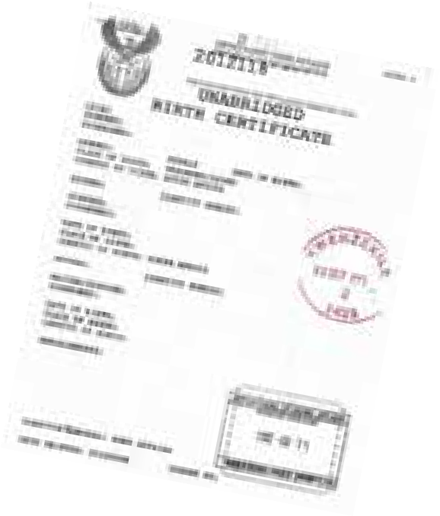
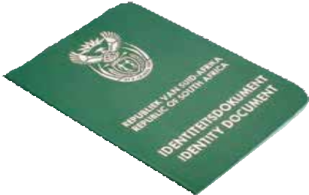

DOCUMENTS REQUIRED TO APPLY FOR FIRST HOME FINANCE
  CERTIFIED COPY of each of the following documents are required when applying for Subsidy:
  Smart Card or a bar-coded identity document of every adult member of the household;
  Birth certificates, bearing the thirteen-digit identity number, for every child member of the household that does not have a bar-coded identity document;
  Proof of South African citizenship;
  Marriage certificate for any union solemnised in terms of civil law;
  Affidavit for any union solemnised in terms of customary law;
  Divorce settlement agreement, to prove custodianship;
  Court order or order issued by the Commissioner of Child Welfare, to prove guardianship; and,
  Proof of sources of income.

Slide 10
SUBSIDY RELATED DOCUMENTS REQUIRED
If applying for a Subsidy with any type of option allowed in Policy:
  Home Loan Approval in Principle/Grant letter from an accredited Lender for mortgage and non-mortgage / Proof of community savings or stokvel’s resolution confirming building loan,
  Proof of own resources or savings when applying for subsidy to add to own resources.
  If will use subsidy only, none of the above are required
Agreement of sale for the residential property if buying existing property (stand or house) in urban areas OR Permission to Occupy in rural areas, accompanied by a letter from the applicable Traditional Authority confirming that the seller is granted permission to on-sell the property.
Title deed/Letter of stand allocation issued by a Municipality in urban areas OR Permission to Occupy (PTO) issued by a Traditional Council in rural areas, if building a house on a stand, approved building plan, building material, labour quotations and NHBRC enrolment certificate

Slide 11
INCOME CONSIDERED AND PROOF OF SOURCE
Income refers to single or joint gross household income excluding incidental income e.g. commission, overtime but includes housing allowances as made available by employers:
  Basic salary and/or wages.
  Income received through self-employment.
  Any retirement or disability benefits received on a regular (monthly) basis; and
  Where the sole source of income is commission-based, then an average will be calculated over a period of 12 months.
Proof of source of income
  If paid monthly, recent pay-slip not older than 3 months
  if paid weekly, we need four pay-slips not older than 3 months
  if paid bi-weekly/fortnightly - two pay-slips not older than 3 months
  if Self-Employed or Informally employed six months bank statements
    ALL PAYSLIPS ARE TO BE ACCOMPANIED BY A THREE MONTHS BANK STATEMENT FROM THE DATE OF APPLICATION

Slide 12
HOW DO YOU APPLY FOR FIRST TIME FINANCE?
We have moved away from hand delivery of First Home Finance applications and receipt of applications via email
We now have a fully functional Online Portal system to enable automated processing of applications:
  Applicants (beneficiaries, developers, lenders, bond originators, Local Municipalities or any institution assisting beneficiaries) can login to the First Home Finance Application Online Portal – which can be accessed via the NHFC website page https://www.nhfc.co.za/finance-solutions/first-home-finance/ OR via www.firsthomefinance.co.za
  The portal allows for the processing of pre-approval as well as full applications
  The Portal also offers the functionality of verifying the validity of the pre-approval
  NHFC First Home Finance team conducts quality control and if all correct, application is --passed to the CRM system environment for processing
  At each stage of processing, an applicant receives automated message updates on the status of the application
Applicants who struggle with internet access can make telephone to Call Centre Agents on 010 085 2199 for assistance

Slide 13
APPLICATION OUTCOMES
  If application is unsuccessful - Decline letter stating reason/s for decline will be issued
  If application is successful - Funds will be disbursed NB: No First Home Finance funds may be paid directly to any beneficiary or individual seller. Only the following parties may be paid directly
NB: No disbursement will be made for any house not yet enrolled with the NHBRC - House enrolment certificate from the NHBRC before start of the building process is a compulsory requirement
Purchasing Property | The Lender Provincial Department Municipality Attorney
Building Property | The Lender NHBRC-registered contractor Merchant/Materials Supplier Provincial Department Municipality
House-Buying Costs | Attorney

Slide 14
  For more information visit us on the following website pages
    https://www.nhfc.co.za/finance-solutions/first-home-finance/
  www.firsthomefinance.co.za
  CALL CENTRE No.: 010 085 2199
THANK YOU

